Slide 1
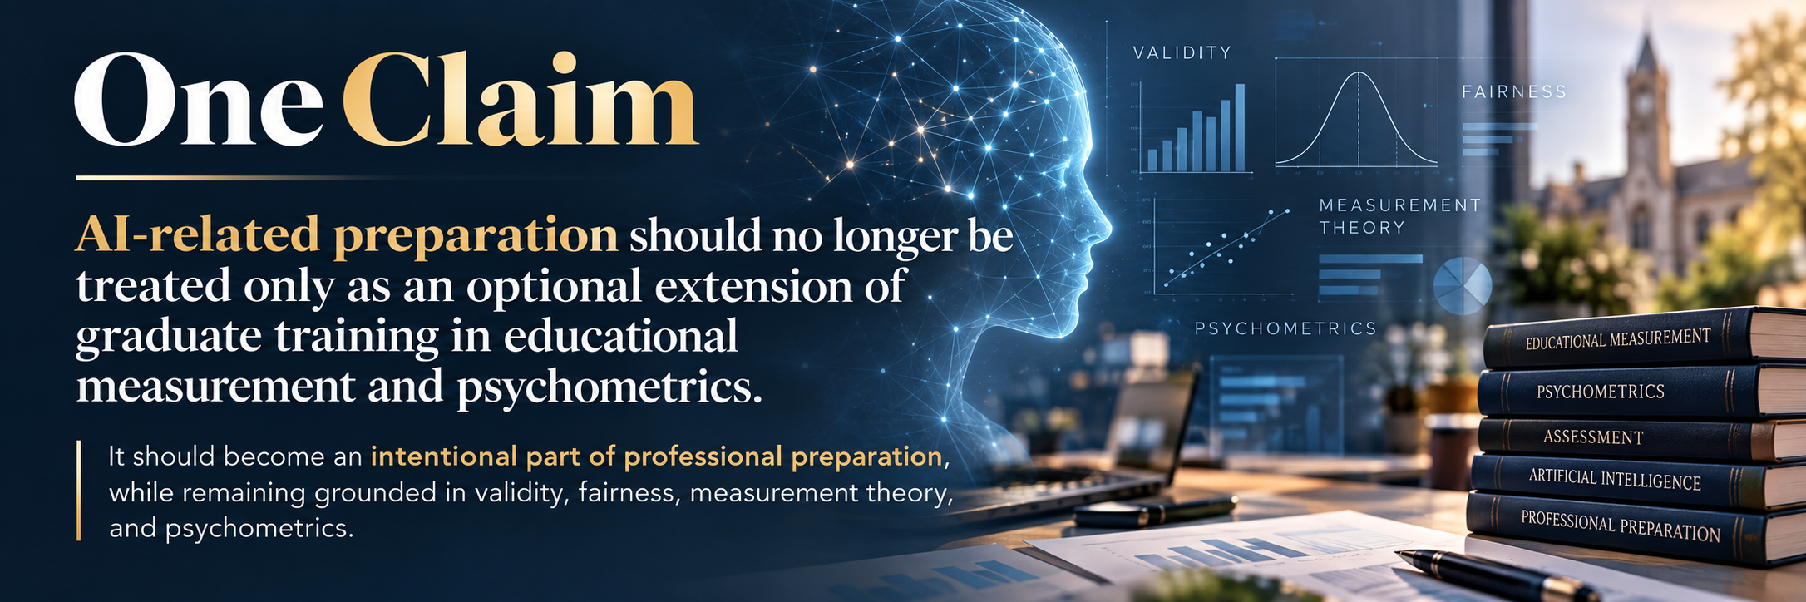
Is AI preparation still something graduate programs can treat as optional?

Slide 2
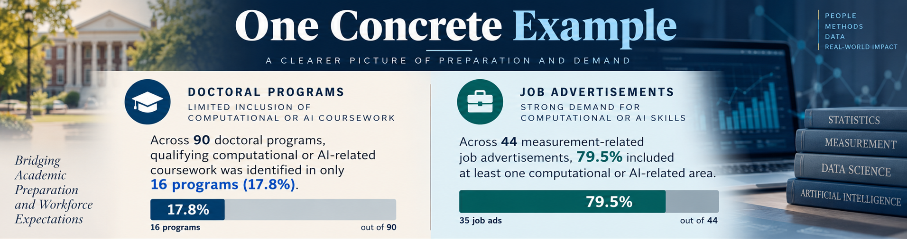
Evidence
Notes:
Most coursework was in stats programs (Artificial Intelligence, Machine Learning, Natural Language Processing, Data Science, Data Mining ,Programming/Computational Skills)
Jobs
GenAI/LLMs
Prompt Design/Fine-Tuning
AI-Enabled Automated Scoring
AI-Enabled Automated Item Generation
AI Model Evaluation/Validation
Human-Machine Agreement
AI Fairness/Bias/Responsible AI

Slide 3
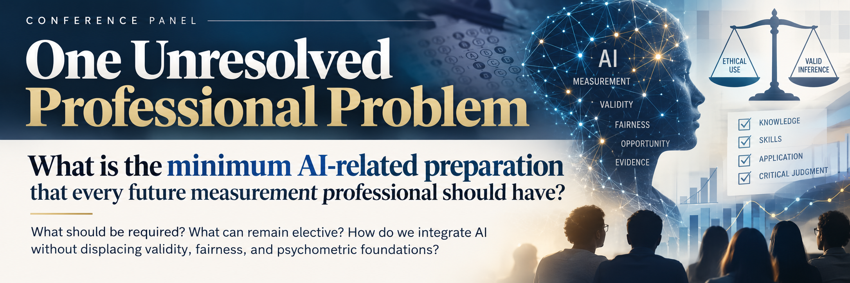
Unresolved Issue
Notes:
We do not yet have a disciplinary answer.
Should every graduate understand how to evaluate an AI-enabled scoring system?
Should they be able to examine bias in an LLM-based assessment?
Should they understand prompt design? Machine learning? Human-AI agreement?
And which of these belong in required preparation rather than electives?
Then connect it directly to the NCME framework:
The professional problem is not simply deciding which new AI tools to teach.
It is determining which AI capabilities are becoming part of competent measurement practice and how to teach them without displacing the validity, fairness, psychometric, and measurement foundations that define the field.

Slide 4




Thank You
Email: mabulela@metametrics.com
Email: mhady001@umn.edu

